Slide 1


RPA Deployment

Slide 2

RPA Deployment
Publish Package
Upload package
Publish library
Deploy process
Upload asset
Roll back plan

Slide 3
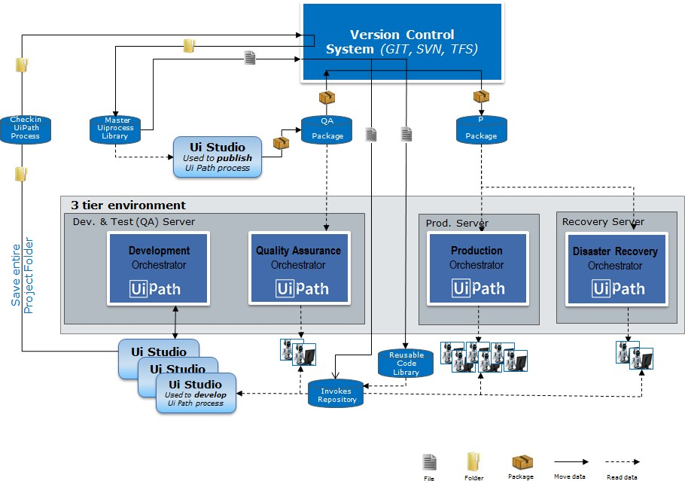

Slide 4
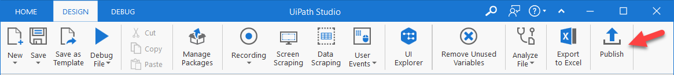
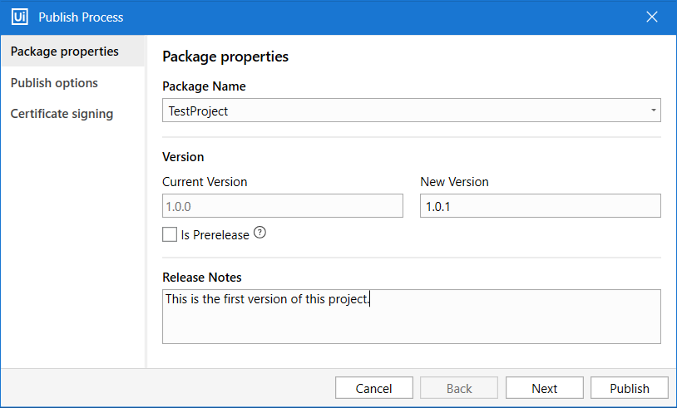
Publish Package
Packages:
Publish package locally: https://docs.uipath.com/studio/docs/about-publishing-automation-projects
Publish locally :

Slide 5
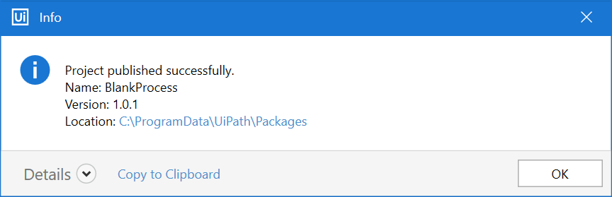
Publish Package locally

Slide 6
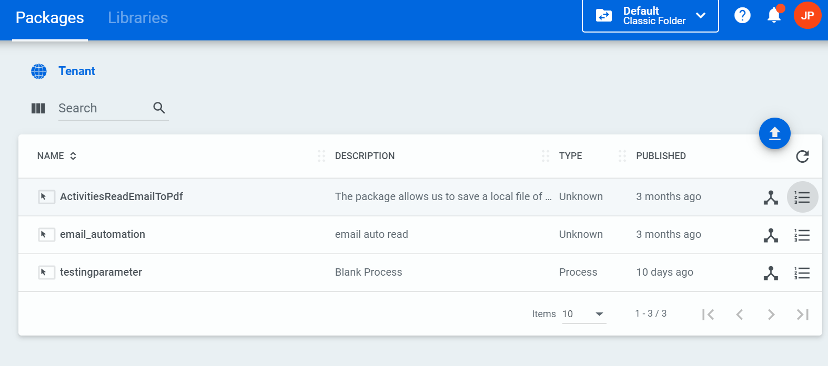
Upload Package
Upload Packages:

Slide 7
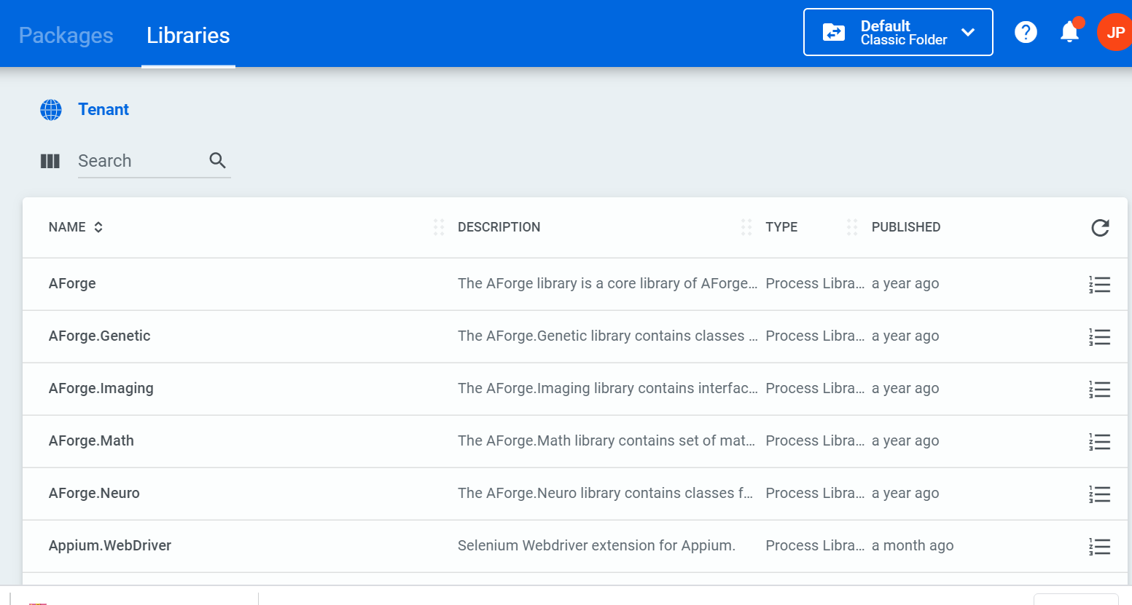
Publish Library
Publish library:

Slide 8
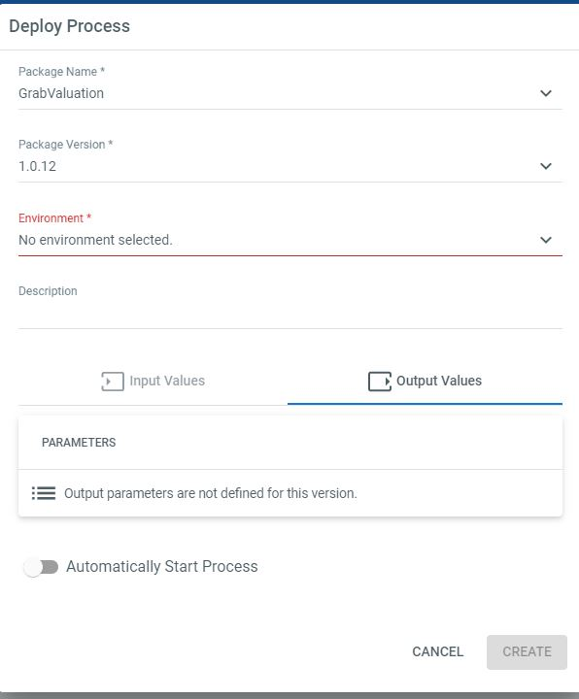
Deploy Process
Processes:

Slide 9
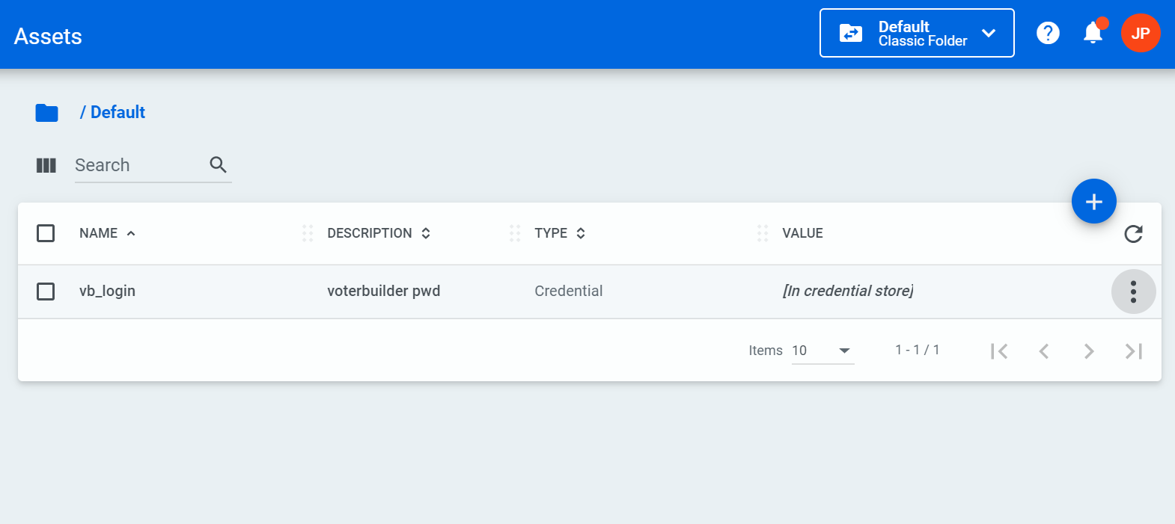
Upload assets:
assets

Slide 10
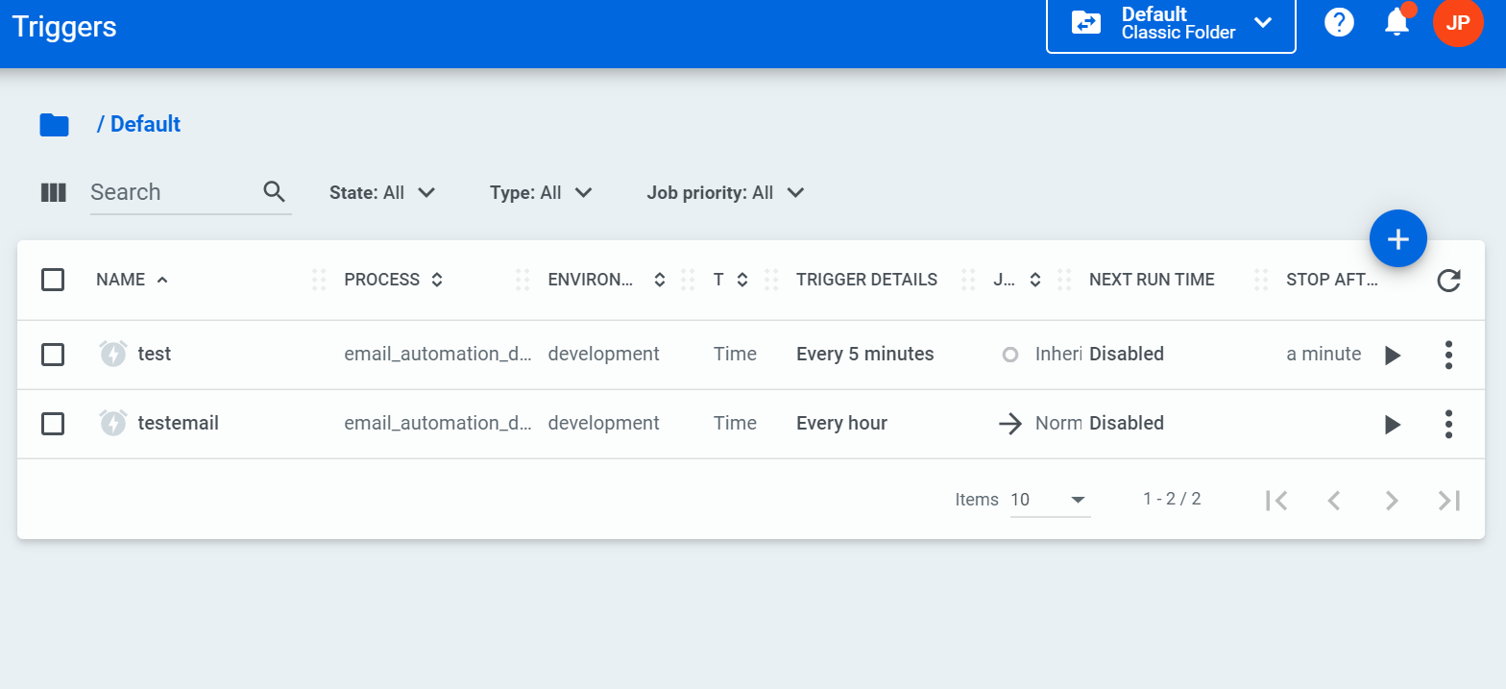
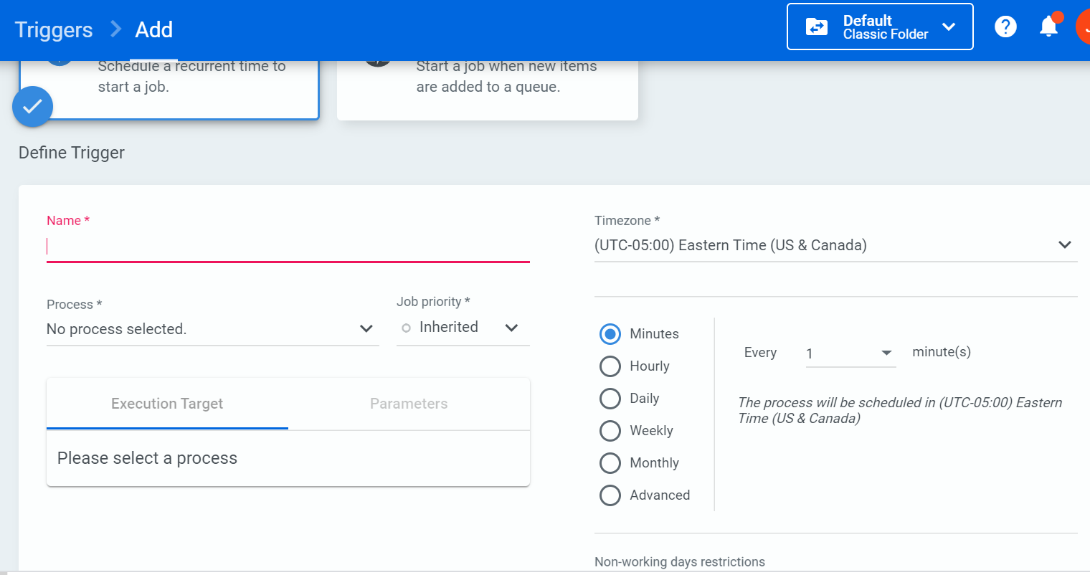
Set up schedule time and jobs

Slide 11
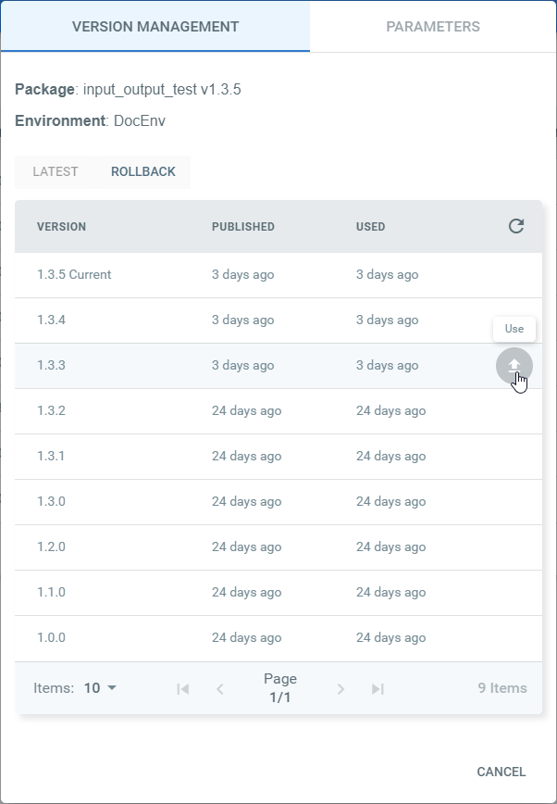
Roll back Plan
Roll back to previous version if encounter issue
✓
✗

Slide 12
Contact information
Jinwei Pan
Tech Lead developer, North America
New York Office
iSoftStone, Inc.
315 West 36th Street
New York, NY 10018
Tel: 425.216.3600
www.isoftstoneinc.com
A STEP ABOVE

